Slide 1
Category review: Chips
June 2020
Retail Analytics
Brand note: If client logo is not required, use alternate title page layout right click slide thumbnail > Layout > Title

Slide 2
Notes:
To view Privacy video explaining how important data privacy is to Quantium, please click here: https://www.youtube.com/watch?v=Zq1QDAkoRzU
or here Q:\Company Reference\Brand & Design\Brand videos\Q Privacy.mp4
At Quantium, we believe that data is the behavioural footprint of humanity and that it has to be treated with the utmost care and responsibility.
Histories, attitudes, indeed lives are stored within it in ways that aren’t always apparent – and that’s what makes its potential so powerful.
To work with it responsibly, sensitively, we set ourselves the highest data privacy protection and governance standards.
We have spent 17 years perfecting privacy-by-design and secure-by-design principles. Central to this is not holding any personally identifiable information about people –
we neither receive it, and put the necessary protections in place to be unable to decipher it.
Every aspect of handling data is safeguarded: from its de-identification, to its encryption – data security is paramount and of the highest grade.
We pride ourselves on gaining the trust of iconic organisations around the world through years of securely working with their data,
and in turn the trust that builds with their stakeholders.

Slide 3
Executive summary
01
Task 1
Mainstream Young Singles/Couples and Budget Older Families contribute the most to chip sales, accounting for the highest revenue share before the trial.
Older Families and Young Families buy more packets per customer, indicating family consumption drives higher unit sales.
Mainstream Singles/Couples pay slightly higher average prices per unit compared to Budget or Premium shoppers.
Salsa products and bulk buyers were removed to ensure only regular chip purchases were analyzed.
02
Task 2
Trial stores 77, 86, and 88 were matched to the most similar control stores based on monthly revenue, unique customers, and transactions per customer before Feb 2019.
Control stores show nearly identical pre-trial sales trends, ensuring a fair baseline for measuring trial impact.
This similarity helps isolate the true effect of the trial intervention during Feb 2019 onward.

Slide 4
01
Retail Strategy Analytics-
Data Cleaning
Customer Segmentation
Product Segmentation
Insights Analysis

Slide 5
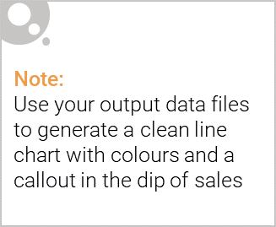
Overview: Key Callouts
Clean the data
Removed non-chip products (e.g., salsa).
Filtered out bulk buyers (200+ packets in one transaction).
Extracted Brand and Pack Size from product names.
Analyze customers by LIFESTAGE and PREMIUM CUSTOMER
Look at sales by brand and pack size

Slide 6

This slide will be commentary on affluence and its effect on consumer buying for the category of chips
Budget customers purchase higher volumes of chips, likely due to affordability.
Premium customers have lower overall chip purchases, possibly preferring healthier alternatives.
Mainstream customers are the largest segment by total sales, balancing affordability and preference.
Average price per packet is slightly higher for Mainstream Singles/Couples, suggesting they choose premium brands occasionally.

Slide 7
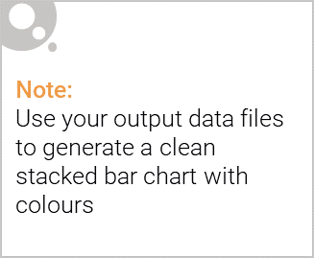
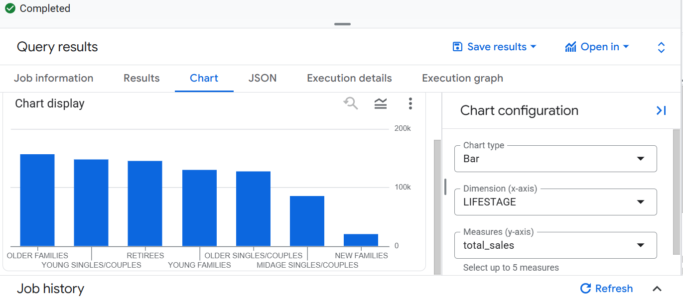
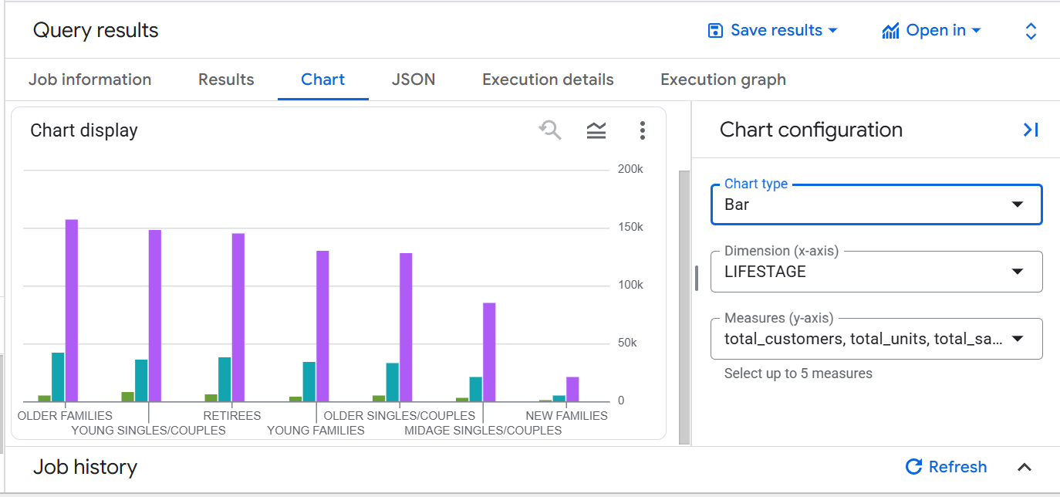
Editable (delete this)
Stretch: Try visualising the proportion of customers by affluence and life stage on this slide

Slide 8
02
Trial store performance

Slide 9
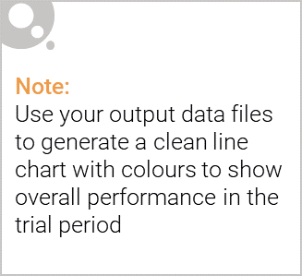
Explanation of the control store vs other stores
Qualities of God Control Store-
Similar monthly sales revenue
Similar number of unique customers
Similar transactions per customer
Pre-Trial Period = Before Feb 2019 → used to match trial with the best control store.
Trial Period = Feb 2019 onward → used to measure the impact of the intervention.(store 77,86,88)
Stores 77 and 86 had similar revenue to control stores but 88 had some difference.

Slide 10
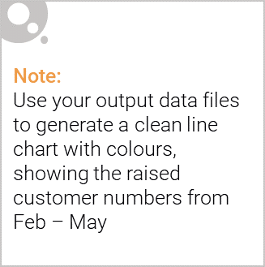
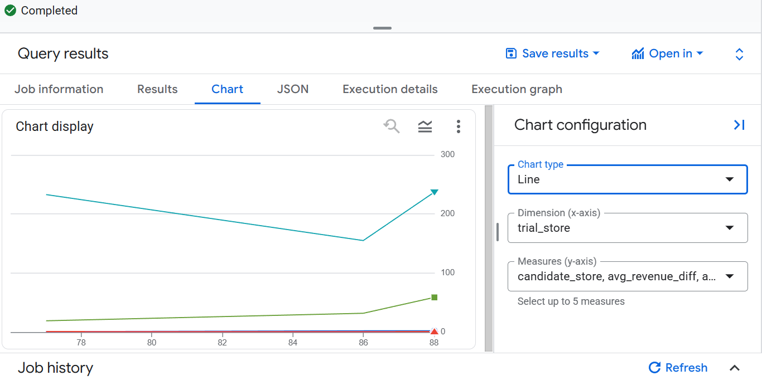
Call out of the performance in the trial store, determining if it was successful

